Slide 1

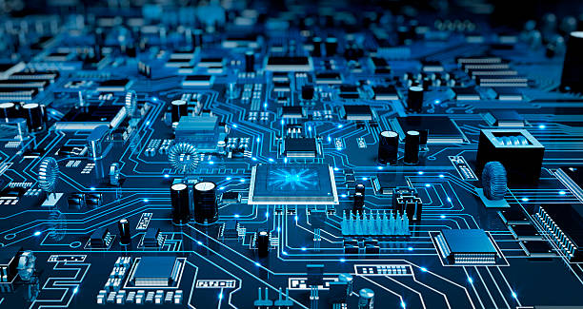

Parts of motherboard
- By nishchal acharya

Slide 2
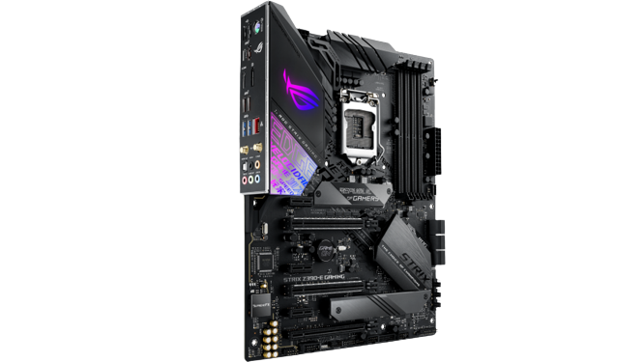
What is mother board??
Motherboard is a printed circuit board containing the principal components of a computer
or other device, with connectors for other circuit boards to be slotted into.
Motherboard

Slide 3
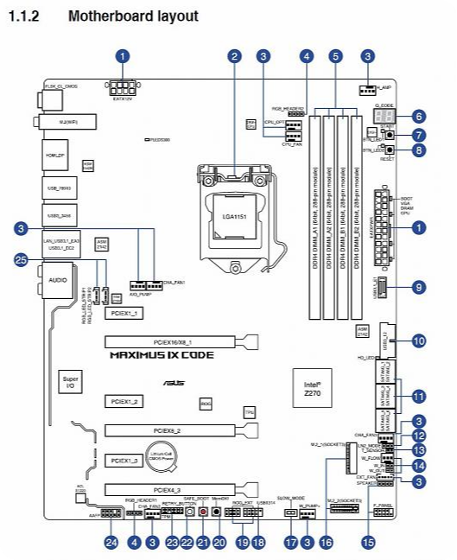
Name of some parts of cpu
Font Pannel
Cpu Fan Supply Connector
Cpu Socket
VGA Port
USB Port
RAM Slot
GPU Slot
Power Supply Slot
Audio Jack connecter

